Slide 1




NEXT GEN EMPLOYABILITY PROGRAM
Creating a future-ready workforce
Team Members
College Name
Student Name : Swathi K
Student ID : au713921104051
Sri Ranganathar Institute of Engineering &Technology -Coimbatore

Slide 2

CAPSTONE PROJECT SHOWCASE
Project Title
Notes Sharing Web Application using Django Framework
Abstract | Problem Statement | Project Overview | Proposed Solution | Technology Used | Modelling & Results | Conclusion

Slide 3
Abstract
This project aims to develop a notes sharing web application using the Django framework. In today's digital age, efficient communication and collaboration are essential in various spheres of life, including education and professional environments. This application provides users with a platform to create, store, share, and collaborate on notes seamlessly.
The key features of the application include user authentication and authorization, allowing users to register, login, and manage their accounts securely. Once logged in, users can create, edit, and organize their notes into different categories or folders for better organization. The application also supports collaboration by enabling users to share their notes with other users, either privately or publicly.
Additionally, the application will provide functionalities for real-time collaboration on notes, allowing multiple users to work on the same note simultaneously. This feature enhances teamwork and facilitates efficient communication among users.
Furthermore, the application will include a search functionality to allow users to quickly find specific notes based on keywords or categories. Users will also have the option to customize the appearance of their notes, such as font styles, colors, and formatting options.
Overall, this notes sharing web application aims to enhance productivity, facilitate collaboration, and streamline the process of creating and sharing notes in various contexts, such as education, research, and business environments. By leveraging the Django framework's robust features and capabilities, the application will provide users with a reliable and user-friendly platform for managing their notes effectively.
Source:GPT3.5

Slide 4
Problem Statement
The primary challenge addressed by this project is the lack of an intuitive, efficient, and collaborative platform specifically designed for the sharing and management of academic notes and resources among students and educators. Despite the availability of various online platforms, there remains a significant gap
in services that cater specifically to academic collaboration, with many students resorting to fragmented and less secure means of sharing study materials. This project aims to leverage the Django framework to develop a user-friendly, secure, and scalable web application that not only facilitates the easy sharing and organization of notes but also enhances the overall learning experience through collaborative features and a community-driven approach
Source :

Slide 5
Project Overview
In an era characterized by digital collaboration and knowledge sharing, our project aims to develop a sophisticated web application utilizing the Django framework, tailored specifically for efficient note sharing among users. This innovative platform addresses the growing need for streamlined information dissemination and collaborative note-taking, offering a robust set of features designed to enhance productivity and facilitate seamless interaction among users.
Embark on this journey with us as we embark on the development of a cutting-edge notes sharing web app using Django, poised to redefine the way individuals and teams collaborate, communicate, and create together.
Source :

Slide 6
Proposed Solution
The proposed solution is to develop a comprehensive, secure, and user-friendly Notes Sharing Web Application tailored for students, educators, and academic
institutions. This application will leverage the Django framework for its robustness, security features, and scalability. Below are the key components of
the proposed solution:
1. System Architecture
Backend Development: Utilize Django for server-side logic, database management, user
authentication, and session management, ensuring a secure and efficient backend structure.
Frontend Integration: Employ HTML, CSS, and JavaScript, alongside Django’s template system, to
create an intuitive and responsive user interface that enhances user experience.
Database Design: Design a relational database schema that efficiently stores user data, notes,
categories, and interactions to facilitate quick retrieval and secure storage of information.
2. Core Features
User Authentication and Authorization: Implement Django’s built-in authentication system to manage
user accounts, secure login/logout processes, and ensure user data privacy.
Notes Management: Enable users to upload, download, and manage notes in various formats (PDF,
DOCX, PPT, etc.), with features for creating, editing, and deleting notes.
Collaboration Tools: Incorporate features for users to comment on notes, rate them, and engage in
discussions, fostering a collaborative learning environment.
Source:GPT4

Slide 7
3. Security and Privacy
Implement Django’s security best practices to protect against common vulnerabilities such as SQL injection, Cross-Site Scripting (XSS), and Cross-Site Request Forgery (CSRF).
Ensure data privacy by adhering to regulations such as GDPR for the handling of personal information.
4. Scalability and Performance
Design the application with scalability in mind, allowing for easy adaptation to increased user numbers and
data volume without performance degradation.
Utilize Django’s caching framework to enhance application performance and reduce server load.
5. User Experience (UX) Design
Follow a user-centered design approach to create an accessible and engaging platform, ensuring that the
UI/UX caters to the needs and preferences of the target audience.
Implement responsive design principles to ensure the application is accessible across various devices and
screen sizes.
6. Testing and Quality Assurance
Conduct thorough testing, including unit tests, integration tests, and user acceptance testing (UAT), to
ensure the application is reliable, secure, and user-friendly.
Utilize Django’s testing framework to automate test cases and ensure code integrity.
Source :GPT4

Slide 8


Technology Used
Front-end
Back-end
Source :

Slide 9
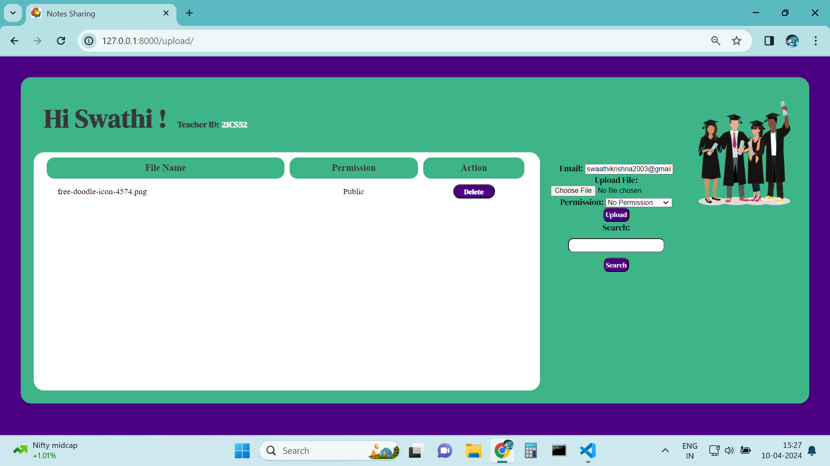
Modelling & Results
Source :

Slide 10
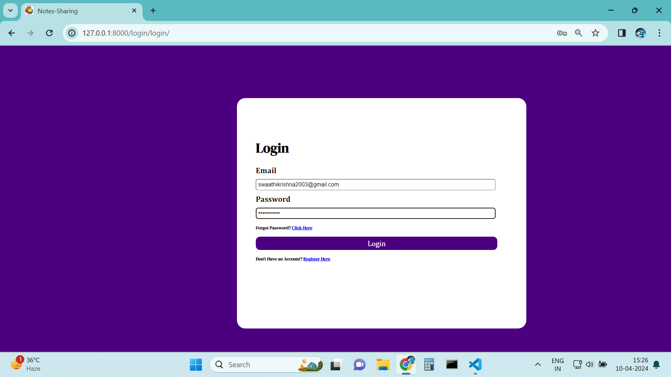
Homepage

Slide 11
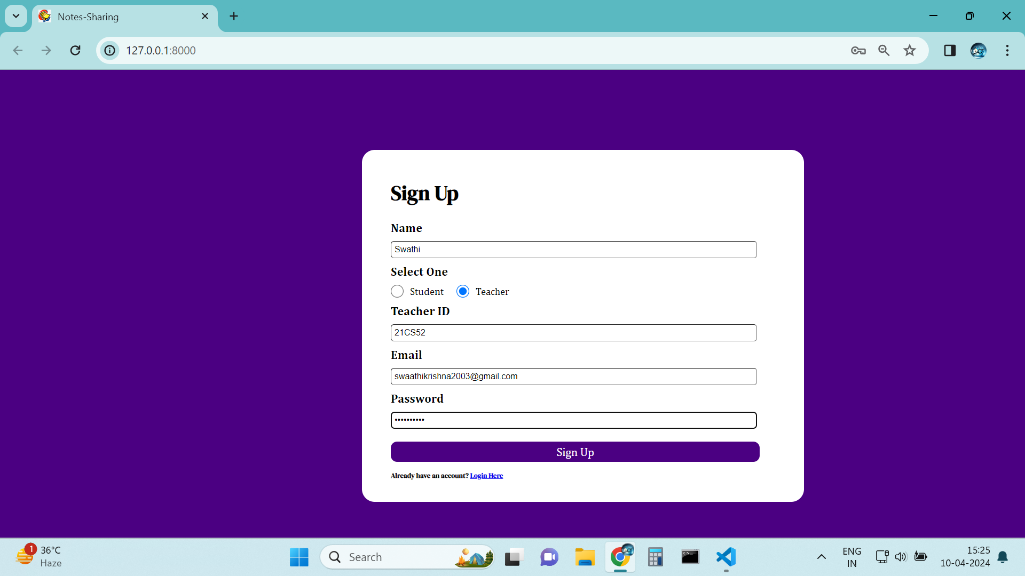
USER PROFILE

Slide 12
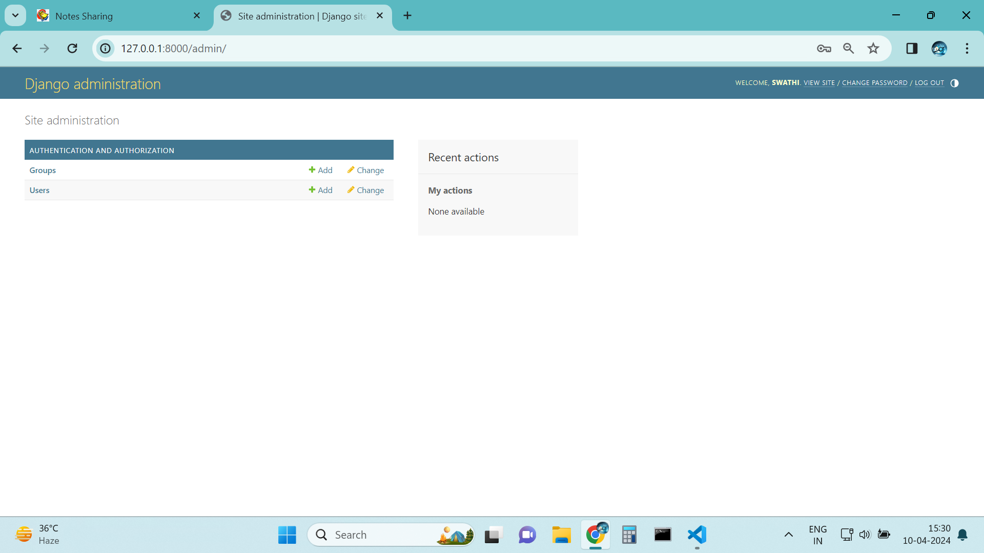
ADMIN-Page

Slide 13
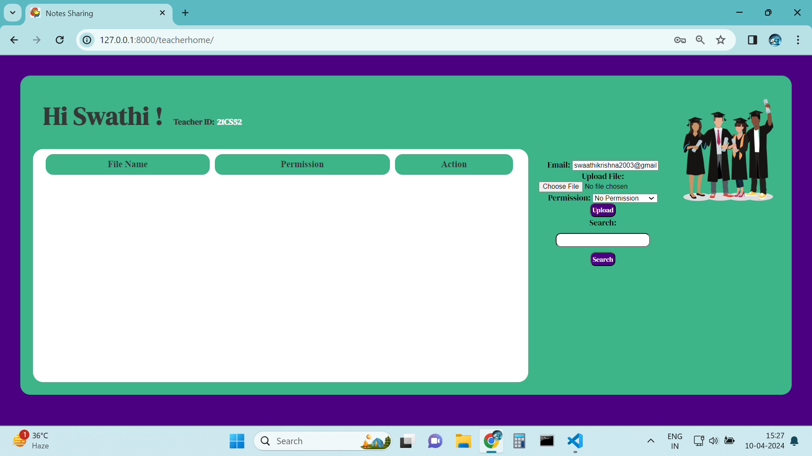
Departments-Page

Slide 14
Future Enhancements:
Potential improvements or additional features for future iterations.
Integration with third-party services (e.g., Google Drive, Dropbox) for note storage.
Real-time collaboration features.
Mobile application development for note access on the go.
intelligent Note Organization.
Offline Access and Synchronization.

Slide 15
Conclusion
Summary of the project overview.
Importance and potential impact of the notes sharing web app.
Acknowledgment of contributors (if applicable).
The Notes Sharing Web Application with Django framework serves as a valuable tool for individuals, educators, professionals, and organizations seeking to streamline their note-taking processes, enhance collaboration, and facilitate knowledge sharing in an efficient and secure manner.
Source :

Slide 16
Thank You!
Notes:
Thank You !!

